Slide 1
DSNA
PARIS – CDG
4th. SAFETY FORUM
Active Safety Nets
Brussels
June 7th. – 8th. 2016
Ground Safety Nets
The use of ground safety nets as part of a global SMS strategy
Presented by :
Jean-Marc FLON DSNA Paris-CDG – Gal Manager ATS

Slide 2

Outline
-------------------------------------------------------------
  Introduction : Challenges ahead
  System’s Performance : A new approach on Safety Management
      Use of Safety Nets
      Risk Perception
      Risk Management
      Results
  Way Forward: Enhancing ground/cockpit cooperation
      CDG’s March 2012 safety event
      Use of APW in shared threats’ management
  Conclusion
4th Safety Forum – Active Safety Nets, Brussels 7-8 June 2016

Slide 3
Introduction: Challenges
-------------------------------------------------------------
Challenges ahead
  Traffic Growth
  Pressure on System and Processes (FBC concept)
  New Procedures increasing Complexity of Operations
  Automation
Issues:
  Maintaining/Enhancing Safety Performance
  Human Centered Approach
  Adaptivity: Resilience vs Brittleness
  Identifying local rationality and weak signals
  Shared Approach
4th Safety Forum – Active Safety Nets, Brussels 7-8 June 2016

Slide 4
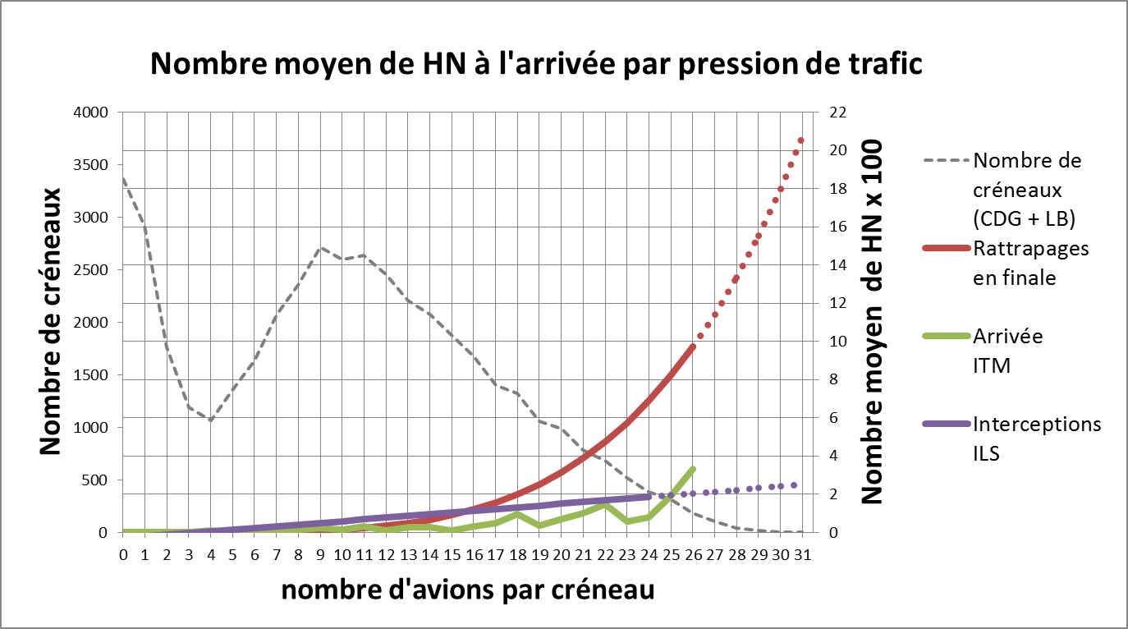
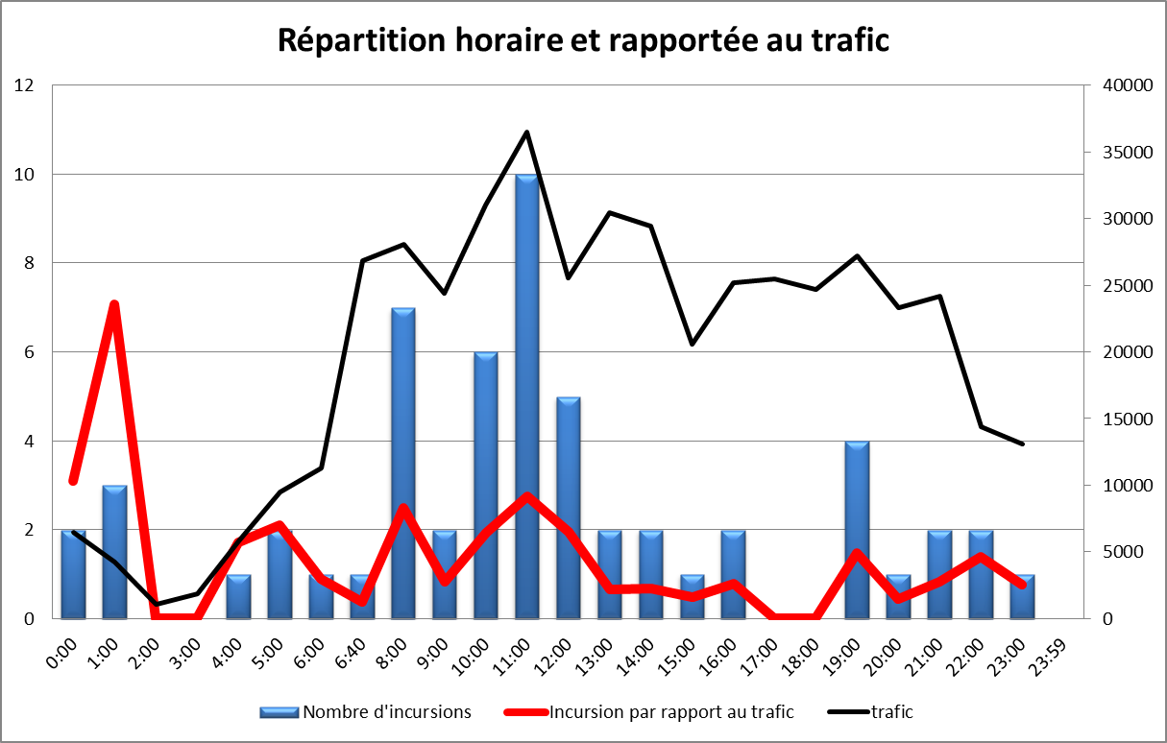
=> A new approach is needed
PERFORMANCE: A new Strategy -----------------------------------------------------------
Capacity versus Safety: CDG’s Safety Unit Analysis:
  SMIs on approach
  Runway Incursions
Ensuring a new and shared approach on Risks:
  Safety analysis : linear model of cause to effect analysis of past unwanted outcomes (limited quantity and quality)
  System’s Safety considered as intrinsic value (measured by indicators) rather than created by system’s strengths and front line actors adaptivity from which we can learn
  Blunt edge vs sharp edge perception of negative events
  Assessing FLA’s Risk perception and Risk management
4th Safety Forum – Active Safety Nets, Brussels 7-8 June 2016

Slide 5
SAFETY NETS: Part of SMS Strategy
-------------------------------------------------------------
ATC Safety Nets:
Analysis of system’s performance
Comprehensive view of “unwanted” events occurences
Assessing levels of risk perception
Allowing management dialogue on risk management
Increased Ground / Cockpit cooperation
Remedial loop under certain circumstances
Shared threats management and increased ability to recover
Integral part of ATC procedures
Definition of operating procedures and ground cockpit interface
4th Safety Forum – Active Safety Nets, Brussels 7-8 June 2016

Slide 6


SAFETY NETS: Risk Perception
-------------------------------------------------------------
4th Safety Forum – Active Safety Nets, Brussels 7-8 June 2016

Slide 7
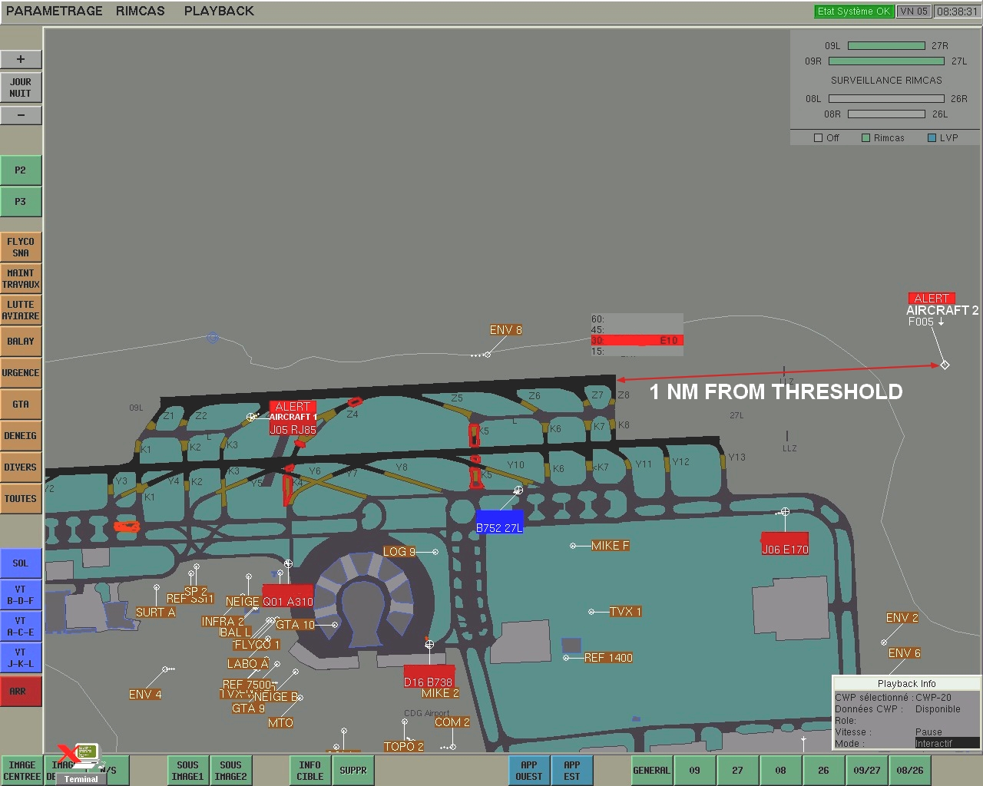
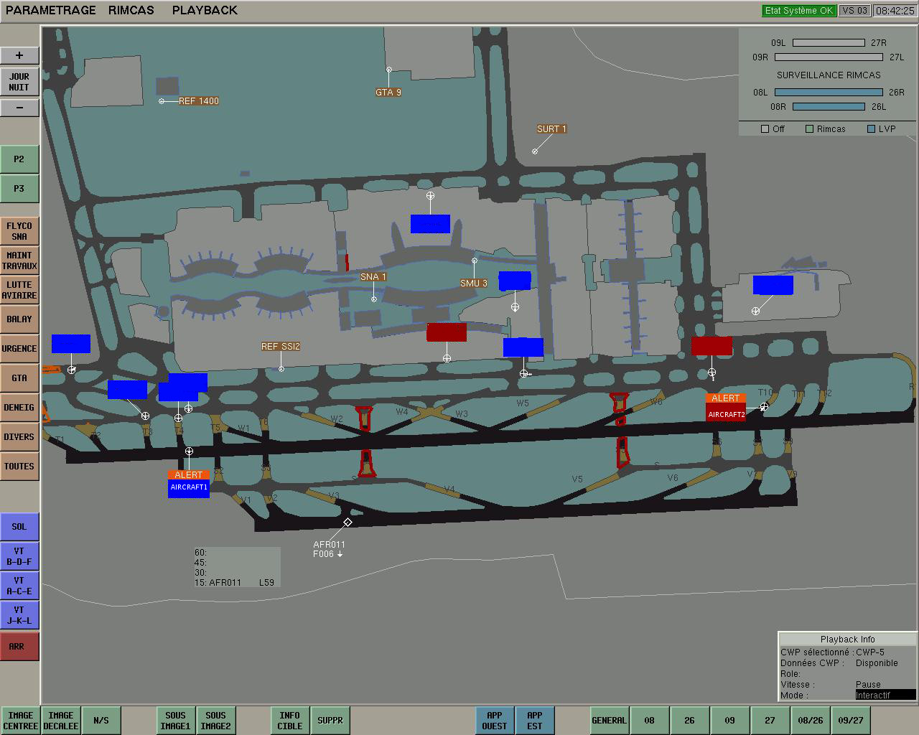
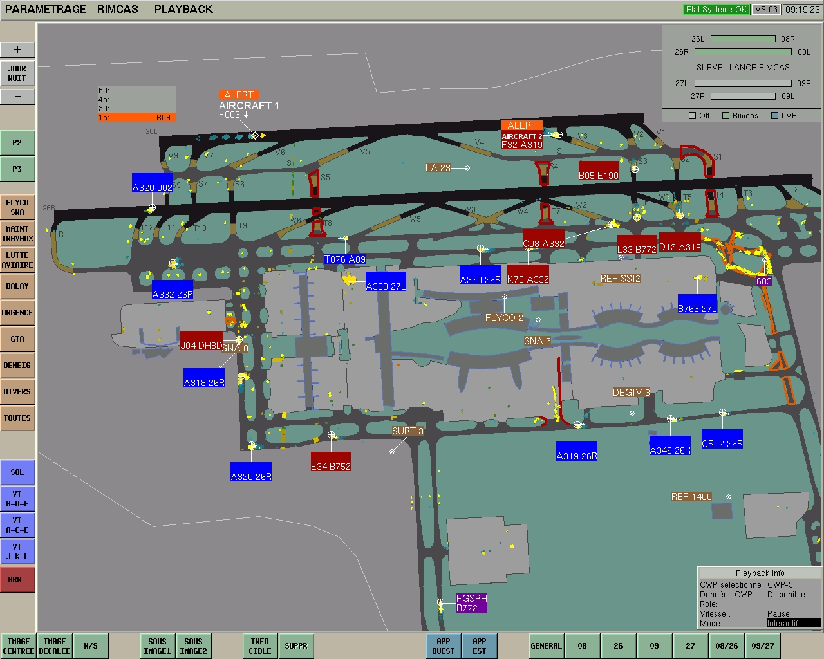
SAFETY NETS: Risk Management
-------------------------------------------------------------
  RIMCAS (A-SMGCS Level 2)
The conflictual clearances issue
Type I
Type II
Type III
4th Safety Forum – Active Safety Nets, Brussels 7-8 June 2016

Slide 8
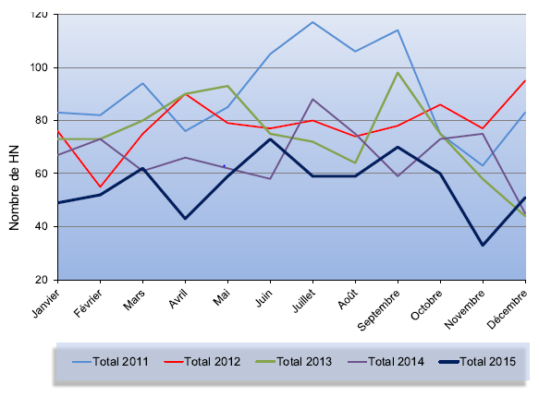
PARIS-CDG SKPIs: Results
-------------------------------------------------------------
  Separation Minima Infringements
  Runway Incursions
Typologie HN | 2011 | 2015 | %
Total | 1083 | 670 | - 38 %
HN 50 | 38 | 16 | - 58 %
HN 70 | 356 | 107 | - 70 %
HN 80 | 320 | 172 | - 46 %
Significatifs | 26 | 14
Majeurs | 15 | 6
Mouvements CDG-LB | 565 146 | 526 672 | - 6.8 %
Typologie Incursions | 2012 | 2015
Total | 59 | 48
Type I | 14 | 22
Type II | 6 | 4
Type III | 15 | 8
Errors | 5 | 2
4th Safety Forum – Active Safety Nets, Brussels 7-8 June 2016

Slide 9
Ground / cockpit cooperation and shared threat management is a major challenge for the years to come and can be identified as one of the major axis of improvement of any ATC System and its Safety Performance.
WAY FORWARD: Cooperation ------------------------------------------------------------
Fulfilling tomorrow’s demands and Challenges:
  ATC new environment and Projects
  Coherent ATC/Cockpit procedures
  Shared threats management
Safety issues have to be shared with pilots
Ensure Pilots and ATCOs work together for the same goal
Ensure mutual understanding of situation, constraints and challenges
4th Safety Forum – Active Safety Nets, Brussels 7-8 June 2016

Slide 10
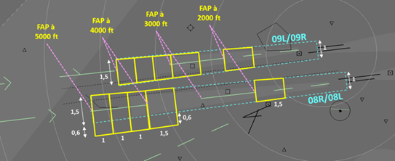
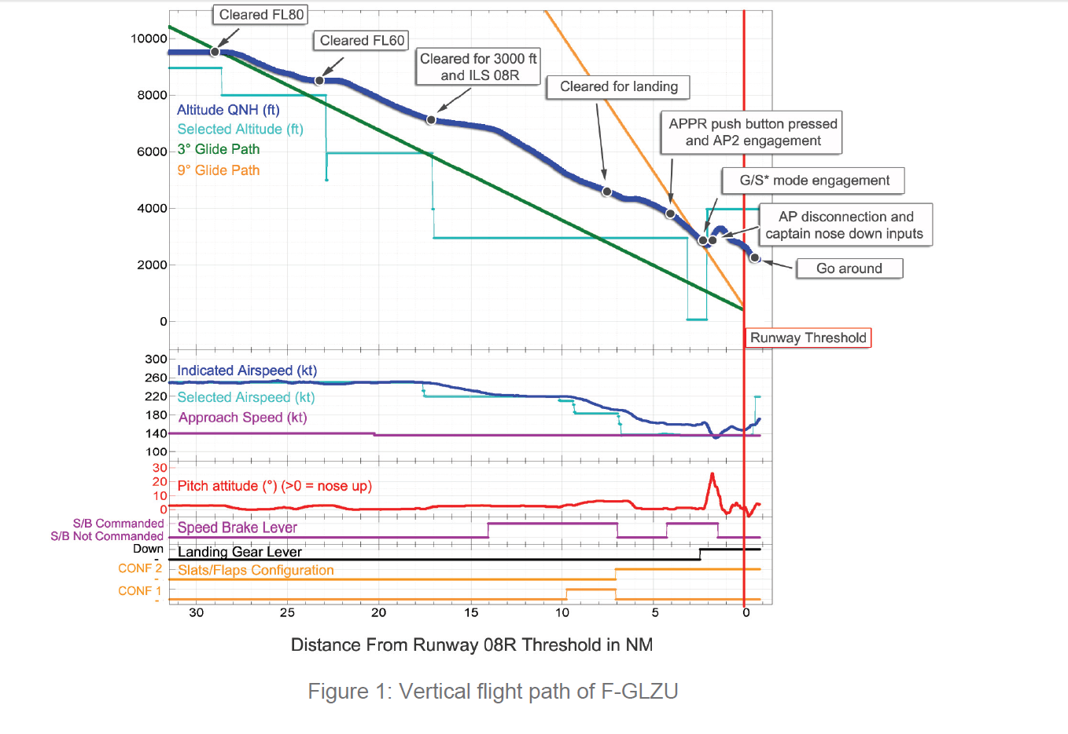
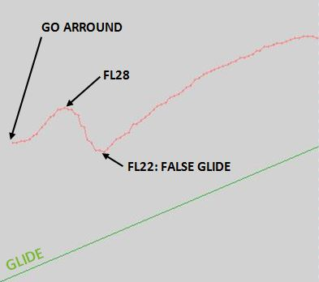
SAFETY NETS: Threats’ Management
-------------------------------------------------------------
  Aera Proximity Warning (APW)
The non compliant/unstabilised approaches issue
Paris CDG March 13th 2012 Event
System definition
4th Safety Forum – Active Safety Nets, Brussels 7-8 June 2016

Slide 11
APW: Implemented System
------------------------------------------------------------
7000 ft
7000 ft
7000 ft
Decision Point
1000 ft ASFC
=
3 Nm to
touchdown
1 NM
1 NM
6000 ft
« You are still too high
on final approach,
Check your altitude »
500ft
1 NM
500ft
1,5 NM
500ft
4500 ft
400ft
ILS
3 ° 5,24 %
4,5 Nm without alarm
« standard » FAP
at 5000 ft QNH
=
14,1 Nm to
touchdown
FAP at
4000 ft QNH
=
11,2 Nm to
touchdown
1,5 NM
FAP at
3000 ft QNH
=
8,2 Nm to
touchdown
300 ft
FAP at
2000 ft QNH
=
5,1 Nm to
touchdown
Distances : example of 08R
RWY
4th Safety Forum – Active Safety Nets, Brussels 7-8 June 2016

Slide 12
Safety Nets : Conclusion
-------------------------------------------------------------
Safety Nets : Tools at the core of Safety Culture and Safety Management process
Thorough and comprehensive analysis of “unwanted” outcomes and performance
Indicator of variability and trade-offs that are part of everyday job
Allows identifying potential weak signals and phenomena of overconfidence and normalization of deviances
=> Risk Understanding / Acceptability : define marginal boundary. Accountability
Safety Nets : Human centered automation
No creation of reliance with CTL at the forefront of decision making
Assessment of situation and risks and remedial actions using core skills
Safety Nets : Increased Ground / Cockpit cooperation
Remedial loop under certain circumstances
Shared threats management and increased ability to recover
In our complex system => Need to ensure Resilience
4th Safety Forum – Active Safety Nets, Brussels 7-8 June 2016

Slide 13
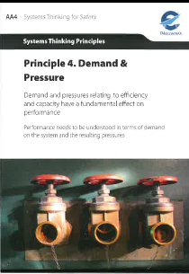
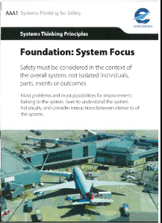
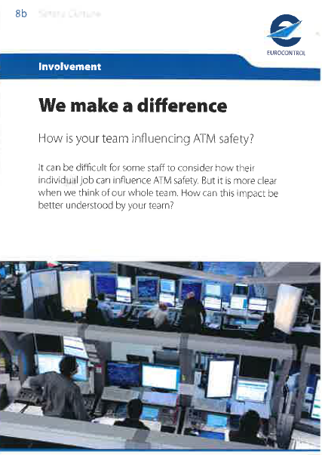
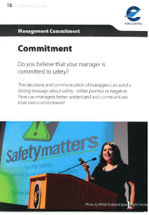
CONCLUSION
--------------------------------------------
We live in a world of change and we can’t rely on patterns of past successes
Higher levels of productivity will produce more brittleness
We have to prepare for production pressure that is coming
We have to understand, ensure and direct potential of adaptivity at all levels
We have to support a smooth extensibility of our operations and of the system as a whole to ensure its resilience
4th Safety Forum – Active Safety Nets, Brussels 7-8 June 2016
Notes:
Visite salle de ré écoute?

Slide 14
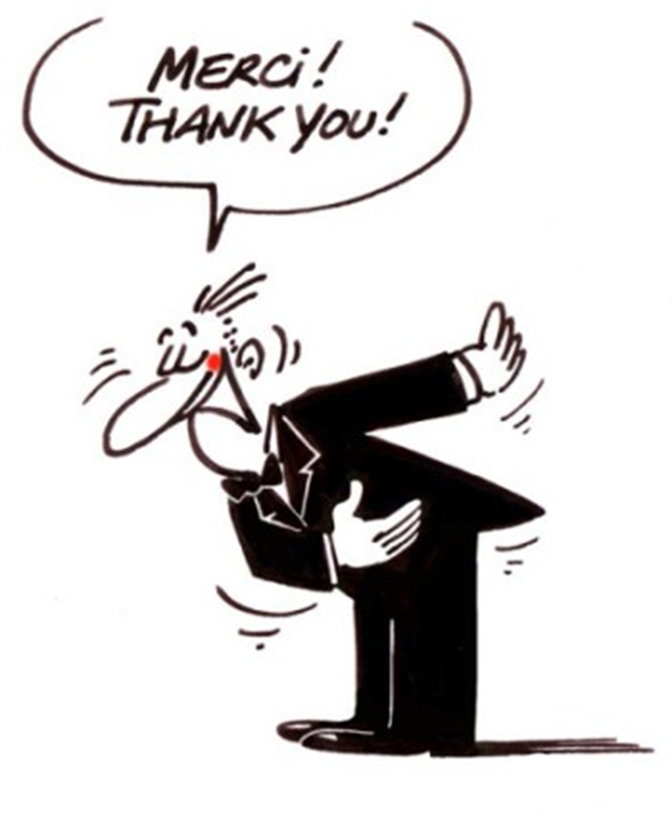

4th Safety Forum – Active Safety Nets, Brussels 7-8 June 2016

