Slide 1
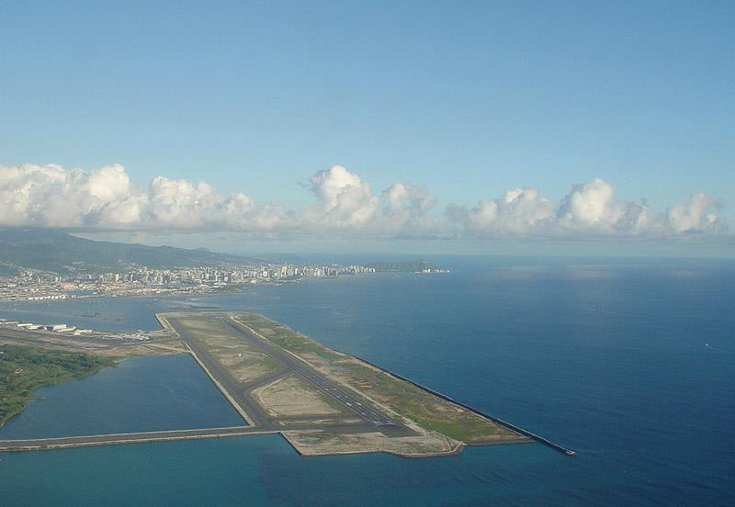

An Active Safety Net for Runway Overruns
Presented by Logan JONES
Airbus Flight Operations Solutions

Slide 3
Overview of Safety at Landing
Hull loss and significant damage
Veer-Off
Overrun
Data Source: IATA Runway Safety, Accident Analysis Report, 2010-2014

Slide 4
Overview of Safety at Landing
Including Minor incidents
Real occurrence rate is underestimated when using accident statistics as many events resulted in only minor damage
From May 2015 to May 2016,
17
at least runway overruns
of commercial jet aircraft
Data Source: Various internet sources

Slide 5
Overview of Safety at Landing
0%
5%
10%
15%
Small deviations can have large impacts on the landing distance
Nominal In-Flight Landing Distance
15% safety factor
5kt Tail-Wind
Each additional 10ft above threshold over 50ft
Each additional 1s of flare over 7s
Each additional 1s delay of pedal braking
Each additional 3s delay applying max reverse
Runway Friction 10% worse than expected

Slide 6
Overview of Safety at Landing
How can we enhance safety at landing?
Provide the right tools to the flight crew, to make the right decision at the right time

Slide 8
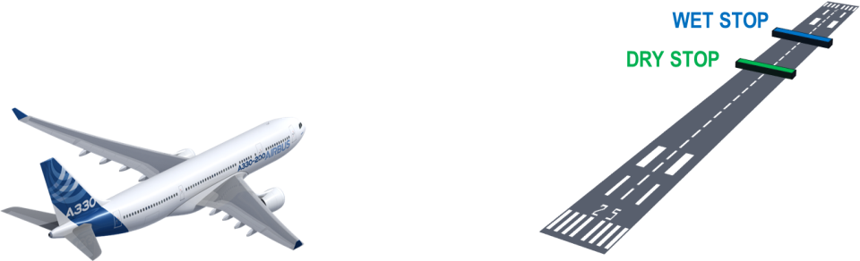
Designing ROPS
ROPS functions by continuously monitoring the aircraft’s position and calculating the distance needed to safely stop the aircraft.
If at any time, this distance becomes longer than the remaining runway length, ROPS triggers an alert.

Slide 9
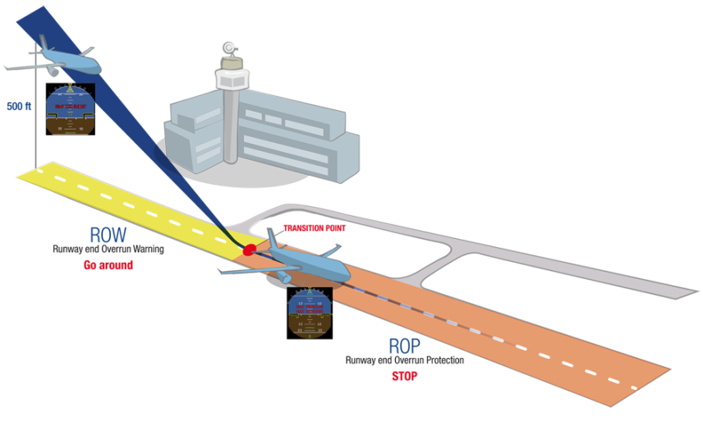
Designing ROPS
Clear alerts with associated Airbus Procedure
400ft
Go-Around
Max Braking
Max Reverse

Slide 10

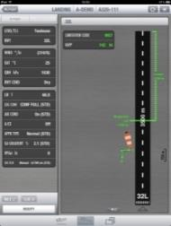
Designing ROPS
Airbus ROPS is built on the same hypotheses used for the Airbus In-Flight landing distances. All of which are based on the recommendations from the TALPA ARC working group and recommended by the FAA in AC 25-32
Consistency
In-Flight LD

Slide 11




Designing ROPS
Prototype - 2004
A380 - 2009
A320 - 2013
A350 - 2014
A330 - 2015
Incremental Design
2009 Dry/Wet Runways – Autobrake Only
2010 Dry/Wet Runways – All Braking Modes
2014 Dry/Wet Runways with Runway State Selector
2017 Contaminated Runways with Runway State Selector
Research
Oct. 1998 - Feb. 2002

Slide 13
Feedback
Controlled
Entry-into-Service
It is Airbus’ practice to limit the installation of new functions to a limited number of companies in order to gain operational feedback.
Airbus setup a dedicated team of ROPS experts to closely follow ROPS introduction and act as an interface between the design team and the customer
ROPS Support

Slide 14


Feedback
Open Dialogue
Important to have open dialogue between the airline companies and Airbus.
…
Data is key not only in understanding issues but also to test future design optimizations. There should be effective means for data exchange for safety
Data Exchange

Slide 15
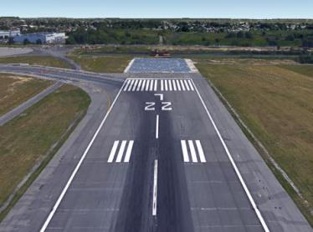
Feedback – An Example of Data Exchange and Dialogue
What the Pilot Sees
What ROPS Sees
ROP Low Speed Alerts
Data Exchange
Airbus Analysis
Debrief with Airline
Design Optimization

Slide 16
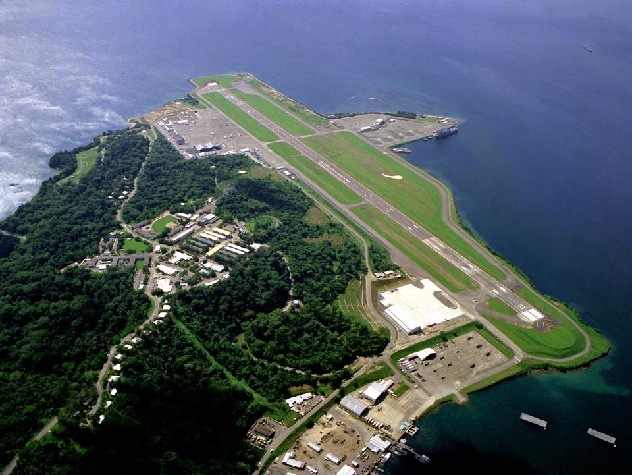


Feedback
Runway Database & Airport AIP Data
Accurate, reliable and up-to-date information in the runway database is key to correct functioning of ROPS.
Photo by PH2(NAC) David Sanner [Public domain], via Wikimedia Commons

Slide 17
Feedback
Flight Crew Understanding
Provide the right tools to the flight crew, to make the right decision at the right time
Need to ensure the end-users, the pilots, understand the system.
Documentation
Training
Guidance Material

Slide 19





ROPS Status on Airbus Fleet
As of March 2016 ROPS is operating on 419 aircraft
1700+ on backlog
153
38
Operators
233
20
13

Slide 20
Global Standardization
The industry is working together towards global standardization
EUROCAE Working Group 101 - Runway Overrun Awareness and Alerting Systems
International representation working together to create a Minimum Operational Performance Standard
EASA RMT.0570 – Reduction of Runway Excursions
The objective of this task remains to increase the level of safety by reducing the number of runway excursions through mandating ROAAS on-board certain large aeroplane categories to be determined

Slide 21
A Global Success
Safety Nets add an additional layer of security but are only one part of the solution.
Aircraft operators, civil aviation authorities, aerodromes and ANSPs all have an important role to play
Together we can reverse the trend of runway overruns and improve safety at landing.

