Slide 1
The Direction of Automation for NATS
Lisa Aldridge
Senior Human Factors Specialist
Human Factors Lead for Automation
NATS

Slide 2

What Do We Mean By ‘Automation’?
A: the general move towards technology carrying out work, either instead of, or in support of humans?
B: the reallocation of function from human to machine ?
C: the new functions that assist people to do their work?
D: the technology that carries out work, either instead of, or in support of humans?

Slide 3
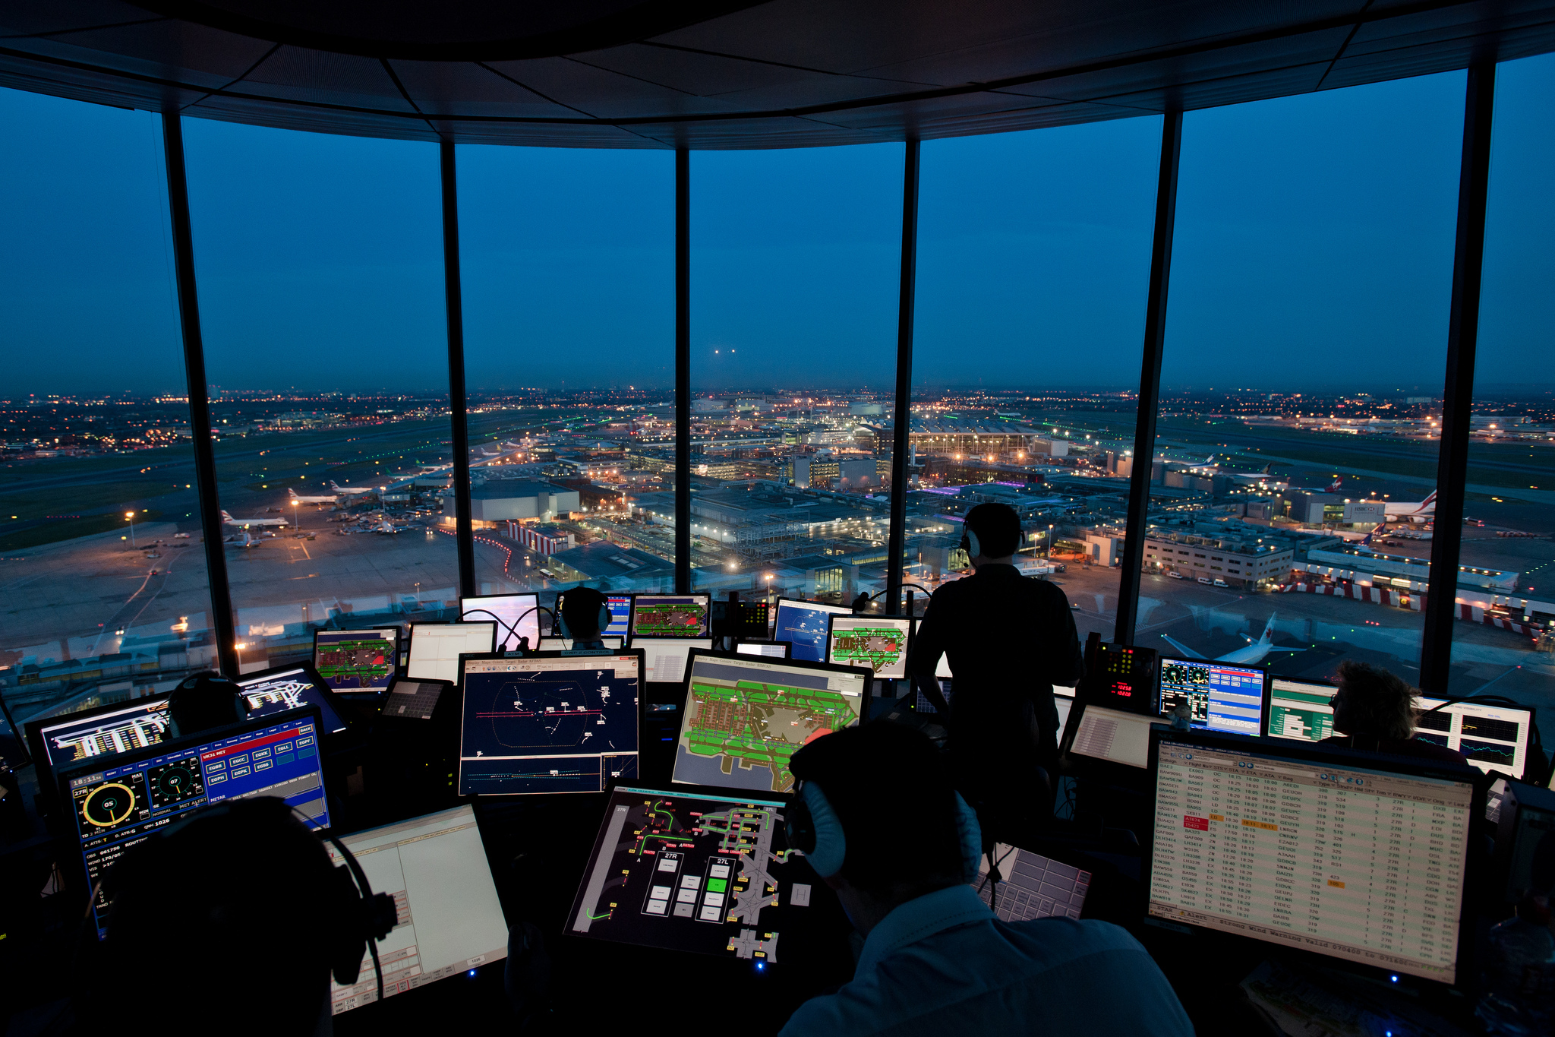
London, Heathrow

Slide 4
What Is Driving The Move Towards ‘Automation’?
Easier?
Cheaper?
Faster?
More Accurate?
More Reliable?
Less Stressful?
Social pressure?
Social normalisation?

Slide 5
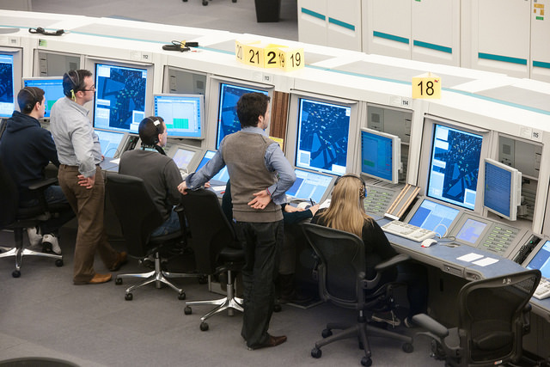
Swanwick Area Control Centre

Slide 6
How Are NATS Approaching ‘Automation’?
“In the ATM Target Concept it is recognised that humans (with appropriate skills and competences, duly authorised) will constitute the core of the future European ATM System’s operations.
However, to accommodate the expected traffic increase, an advanced level of automation support for the humans will be required.”
SESAR CONOPS
‘People Create Safety’
NATS Safety Strategy

Slide 7
Lessons From iFACTS
Engage users early and throughout the design process
Train controllers how to apply the tools, not just how to use the tools.
Validation in limited operational service,
Monitor in service for adaptations to the control task

Slide 8
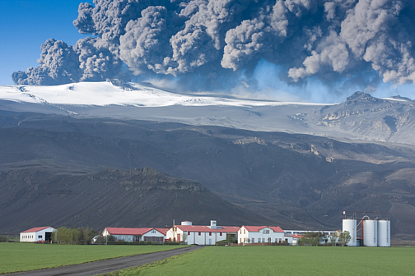
1. Air Traffic Management is Unpredictable
So we need to keep controllers engaged

Slide 9

2. People are Accountable for the Safety of Air Traffic Management

Slide 10
3. Air Traffic Management is Complex
Aircraft Heading, Level, Speed
Aircraft position
Aircraft Type
Approach Type
Airline
Pilot Responsiveness
Wind Profile
Visibility at Aerodrome
Direct Aircraft on
Final Approach
Turn Aircraft
Break off
Apply Speed Control
Knowledge & Experience

Slide 11
4. Automation Creates New Opportunities To Mislead And Confuse Controllers
Judge
Anticipate
Plan
Control
Scan

Slide 12
Red

Slide 13
Green

Slide 14
Blue

Slide 15
Black

Slide 16
Green

Slide 17
Yellow

Slide 18
Blue

Slide 19
5. Controllers Can’t Work Well With Something They Don’t Understand
6. Designers and Maintainers of Automated Systems are Fallible Too.
7. Big Data Creates Big Opportunity for Data Input Error.

Slide 20
8. Humans are Naturally Bad at Monitoring.
I would put a picture here
but it may distract you.

Slide 21

9. Automation Will Fail At Some Point.

Slide 22
NATS Automation Themes
1. Accountability
2. Continuity of Service
3. Error Resilience
4. Allocation of Function
5. Workload
6. Design
7. Training
8. In Service Monitoring
9. Balance of Investment

Slide 23
So What Is The Direction of Automation for NATS?

Slide 24
Lisa Aldridge, Human Factors Specialist, NATS
lisa.aldridge@nats.co.uk
4000 Parkway,
Whiteley,
Fareham,
Hampshire
UK
PO15 7FL
www.nats.co.uk

