Slide 1
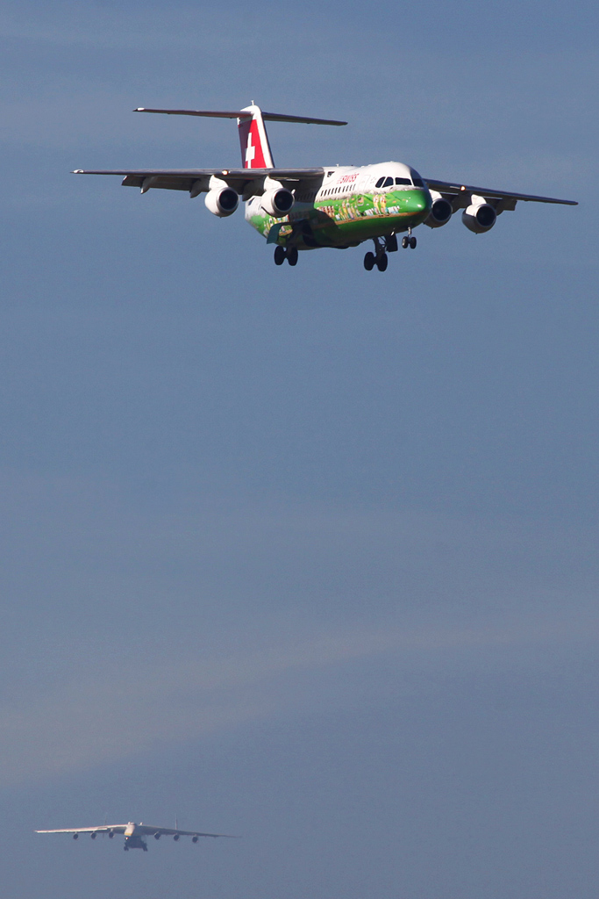
Preventing Level-bust
Operator’s strategies
Capt. Stephen Eggenschwiler
Flight Safety Officer
Swiss International Air Lines Ltd.
2014 Safety Forum: Airborne Conflict
Brussels June 10th

Slide 2
Data Collection
Since 2006 we received 57 reports of unintended level deviation
Only reports with an actual altitude deviation were considered
Crew
Weather
Technical
Misunderstanding
(TCAS RA)
ATC
Notes:
Crew 32 cases
ATC 6 cases
Weather 6 cases
Technical 5 cases
Misunderstanding 8 cases
Cases without a deviation were managed correctly (SOP and awareness)

Slide 3
Weather
…flying in moderate turbulence we were passed by an aircraft 1’000 ft below. We encountered a downdraft and at the same time the other aircraft encountered an updraft resulting in an immediate TCAS RA. We climbed 400 ft whereas the other flight maintained altitude…

Slide 4
Technical
…during level flight with automatics on the AP suddenly disconnected due to an out of trim situation. Aircraft pitched up and A/T increased power. Immediate manual take over of aircraft but still a level bust of 500 ft occurred…
…flight was cleared to altitude 8’000 ft. This was set and confirmed by both pilots. When approaching 8’000 ft CMD realized that altitude preselect showed 7’000 ft. 8’000 ft was confirmed with ATC. Aircraft was levelled off but undershoot of 200 ft could not be avoided…
…as the rate of climb was 2’500 ft/min vertical speed was selected with a rate of 1’000ft/min about 1’400 ft before cleared altitude. FGS captured the altitude but due to the slow reaction of the AP the aircraft overshoot by 300 ft…

Slide 5
ATC
…at FL 159 received reclearance to level off at FL 160. Undershoot of 500 ft…
…at FL 310 cleared to descend to FL 200 to be level within 3 minutes. Passing FL 240 with a rate of descent of 4’000 ft/min ATC ordered «turn left HDG 120°, level off FL 230». Even with AP disengagement an undershoot of 300 ft could not be avoided…

Slide 6
Misunderstanding
Handover to next sector
Similar call signs
Readback hearback issues
Atmospherical disturbances
Language proficiency
Callsign versus flight level e.g. LX1100 – FL110
Unclear or complex SID description
Notes:
Readback for another flight
SID complexity with conditional altitude restrictions

Slide 7
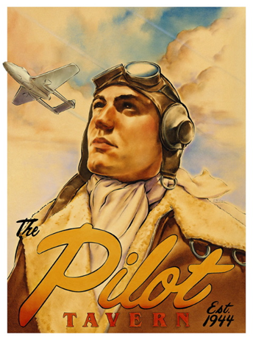
Crew
Flight Crew
Automation
Technical
Training
Aircraft energy
Altimeter
Workload
Manipulation
Distraction
Fatigue
Assumptions
Communication
Callsign
PAX issues
Public address
Small talk
Notes:
Using offside autopilot
Incorrect manipulations e.g. selecting altitude iso speed
Automation trap: …I thought the autopilot was on…/ using offside autopilot
Altimeter setting errors
High workload – operations in areas with dense traffic
Accepting a clearance meant for another flight
Pilot – Pilot misunderstanding
Distractions by cabin crew
Aircraft energy awareness
Technical problems
Medical cases
Public address at inopportune moments
Non flight related discussions
Wrong assumptions
Fatigue
Training flight e.g. low level of experience

Slide 8
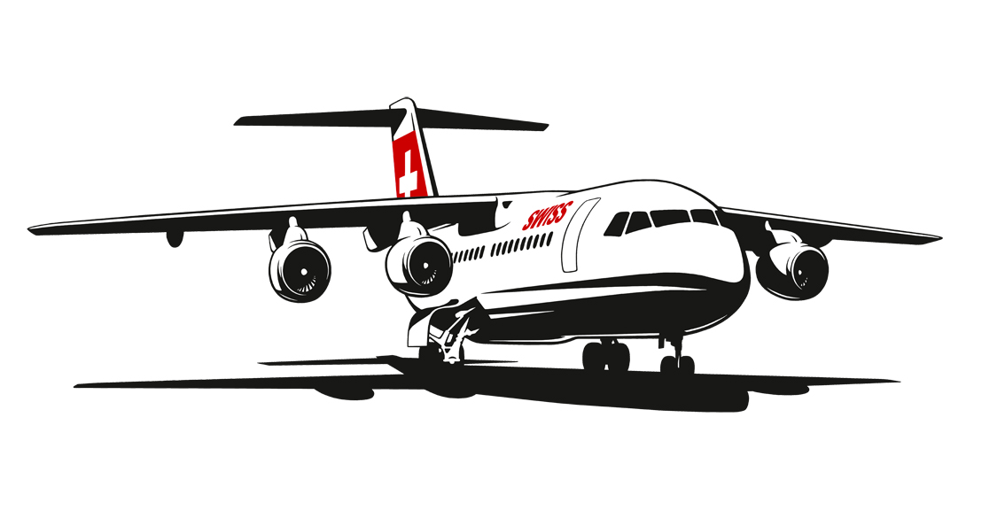
Just Culture
Human nature remains the weakest link
Today’s SOPs are usually well developed and sound
To be able to correct the flaws within it is imperative that the system knows what is going on
To understand an error we need the crews to report events and this will only work with trust in the system
Therefore to manage human error a just culture environment is a MUST
Notes:
discussion with pilots/info to fleet management
FDM/FOQA are useful tools
Only then will we achieve a workable level of system maturity

Slide 9
Risk mitigation
What are we doing?
Ops support
Training
Recurrent
Publications
Awareness
Confidential
reporting
Reporting
Just
Culture
Notes:
Training: pointing out the human traps at an early stage in training
Reporting: why is it important
Recurrent training: keep repeating the message
Confidential reporting: for those that don’t trust the system 100% yet
Publication: sell the message using own examples
Awareness: use all channels to reach the crews (LH crews are difficult to reach)
Ops refresher

Slide 10
Risk Mitigation
What are we doing?
Awareness measures
Altimeter setting errors
Where are the automation traps
Foster awareness for environment and traffic
Publish own cases on a regular i.e. monthly basis
Joint ATCO-Pilot CRM courses
Importance of discipline
Encourage reporting
Operator
Review of SOPs
Encourage the use of intercoms
Use of mode S
Lobby for SID/STAR redesign
Notes:
How to offer support to the crews and at the same time search for risk mitigation
Most cases have some form of communication issue
mentioning hotspots
Continuing effort required to battle complacency
awareness campaigns seem to work quite well
Altimeter errors: use of a questionnaire to learn the details
Auto traps: some may not be that obvious
Pressure differences, who is around me
2nd round SWISS and Skyguide
Discipline: sterile cockpit, information to cabin crews
Reporting needs constant encouragement
SOPs: review and question and possibly change
Intercom: still weak on some fleets (historical: they were never used)
Mode S is an excellent countermeasure
SID STAR e.g. ZHR departures 28 and 16 will meet overhead KLO

Slide 11
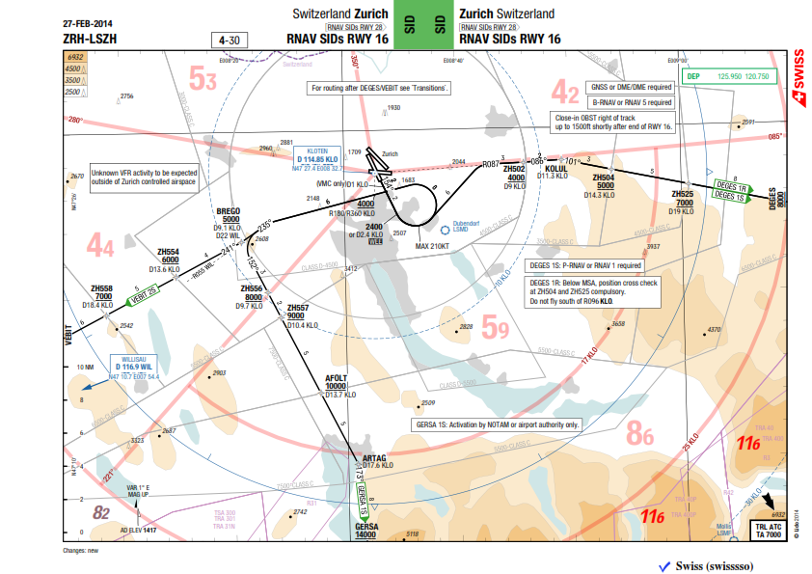
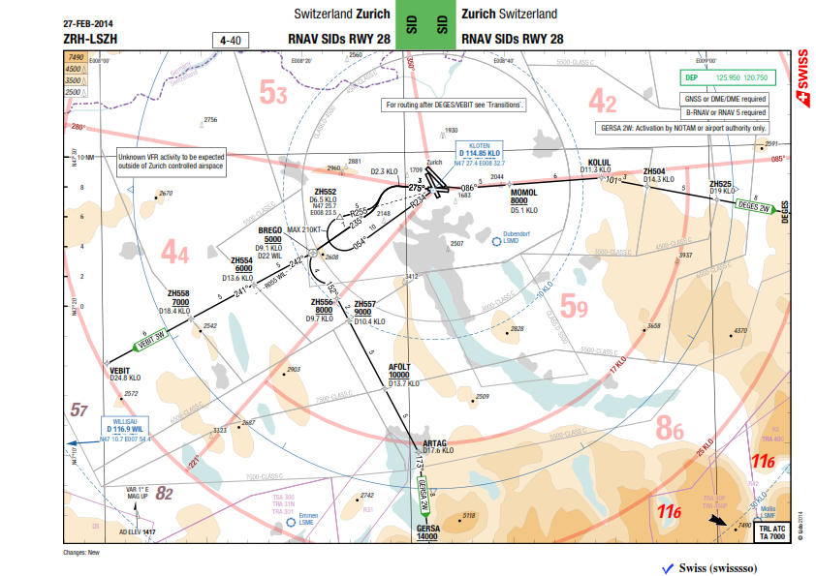
SID LSZH example
Notes:
To demonstrate the necessity of working together. Preventing or reducing levelbust is not just an operator’s responsiblity but the ANSP and regulators have to participate as well.

Slide 12
Thank you for your attention ☺

