Slide 1
Managing Airline Safety Nets
Capt. Bertrand de Courville
Capt. Mattias Pak (Cargolux)
4th Annual Safety Forum
Brussels, EUROCONTROL, 7 - 8 June 2016
Notes:
The contribution of automation to safety during the past decades is huge. No doubt about this. This has been widely recognized.
Nevertheless, from the Cali CFIT accident in 1995 to the mid-air collision in Uberligen in 2002 and others later, examples are numerous where automation have been involved as factors in high profile accident scenarios. Contribution of automation to accident is also a reality which must be better understood.
We know from past accident that feedback about non consequence events (automation mismanagement, failure or anomaly) during daily flight provide opportunities for improvements. But this can only be done if the events are made visible and analyzed in a relevant manner.
Basic safety assumptions could be challenged more easily. We have today enough events and monitoring tools to “test” these assumptions, in a non-destructive way unlike accident.
There is not always a need of massive data to initiate actions.
A single event revealing a high risk operational error in a single airline could trigger large and costless “inspections” worldwide through FDM or other monitoring programs.
Optimizing safety benefits from automations while minimizing their drawbacks is our objective.
We have a good example with what maintenance, manufacturer and authorities do when they have discovered a single critical system malfunctions or structural failure. They do not wait for multiple events and trends before inspecting a whole fleet of aircraft.
Today in the operational field, policies, procedures, practices and training are becoming more standardized. Most of LOC related safety concerns detected and addressed in an airline are potentially an issue in other airlines. In other words operational failures around the world are becoming more « predictable ». Taking a better advantage of it is less expensive than the costs induced by catastrophic accidents.

Slide 2
The big picture of Safety Nets
Control
Safety Nets
are here
Recovery
Operations
Managing Airline Safety Nets – BdC MP
2
7 June 2016
Notes:
Maintenance and flight operations have different perspective but they contribute to the same safety system.
Let’s have a look on it and see how maintenance is influencing it.
This system is a defensive system. It is made of three different natures of “safety barriers” as illustrated here in the “ball in the bowl” metaphor.
The “Control barriers” which help us to operate with enough safety margin, to detect and correct multiple slight deviations that inevitably happen before they have consequence. Errors, deviations, violations, unexpected failures could happen but procedures, equipment, training programs, good practices, professional culture contribute to keep these operations within a safe envelope, in other word to keep it "under control" even if things does not happen exactly the way we would like to.
But sometimes things are going wrong and move out of the safe envelope. The “Recovery barriers” are there to recover from an unsafe situation, out of the safe envelope. These barriers are directly related to a specific hazard and, beyond, to potential accident scenarios. They may activate when the “control barriers” have failed. TCAS Resolution Advisory (‘RA’) or GPWS pull up are “Recovery barriers”.
The “Mitigation barriers” which are there to reduce the losses as consequence of an accident. Escape slides, Emergency beacon, Crash survival design are “Mitigation barriers”.
2

Slide 3
Safety Nets and key questions
CFIT: EGPWS, MSAW …
MAC: ACAS, STCA …
RE: ROPs, Smart Landing …
RI: RAAS/Smart Runway, RWSL, RIMCAS …
  How far they protect us?
  How do we know?
  Can we improve?

Slide 4
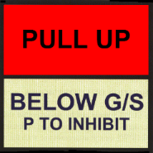
The GPWS/EGPWS example

Slide 5
Some facts about Safety Nets
Safety nets are rarely activated
We tend to “believe” that safety nets will protect us as expected, when needed. How do we know ?
Safety = Equipment + Pilots (ATC) reactions
Some safety nets are not trained
Some safety nets are not monitored (organisational level)
FDM is not taken into account in some safety nets design
Safety nets omitted in incident analysis
Safety nets patent drawbacks

Slide 6
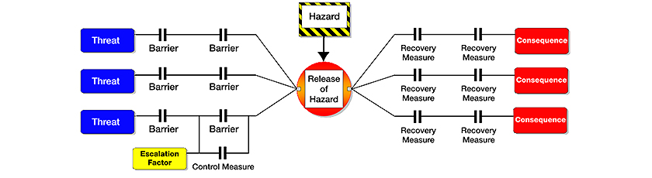
Position and role of Safety Nets
Understanding, « maintaining » and improving them
Safety nets

Slide 7
Safety Nets and SMS
Policy
  Processes to identify, monitor, assess and improve the most critical safety nets should be established
Risk Management
  Position, role, exposure rate and failure modes of Safety Nets related to main accident categories (CFIT, Runway Incursion etc.) should be established and documented. Safety assumptions related to the Safety Nets should be systematically questioned.

Slide 8
Safety Nets and SMS
Safety Assurance
  Critical Safety Nets should be monitored, whenever possible, using a combination of reporting and FDM programs.
  Significant events from other airlines should be used to challenge airlines own Safety Nets
Safety Promotion
  Awareness of Safety Nets strength and weaknesses should be communicated. Positive and negative outcome of significant events should be published with a focus on Safety Nets role.

Slide 9
Safety Nets management review
Accident | Safety Net | Exposure Rate | Available data & analysis Lessons learnt | Improvement Program Safety net efficiency
CFIT | EGPWS
 | MSAW
MAC | ACAS
 | STCA
R. Incursion | RAAS/Smart Rwy
 | RWSL
R. Excursion Landing | ROPS
 | Smart Landing

Slide 10

STEADES Analysis
(Extracts)
Runway Safety Nets
May 2016

Slide 11
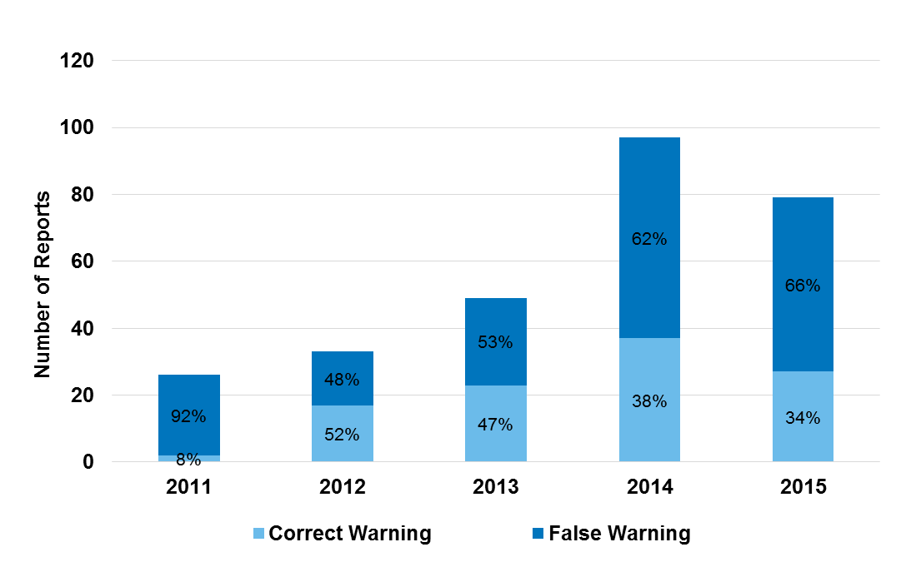
Runway Safety Nets
– Warning Accuracy (perceived)
82% (284) of reports had information in the summary regarding the perceived accuracy of the warning.
Copyright ©2016 International Air Transport Association. All rights reserved.
Subject to restrictions and disclaimer on page 2.

Slide 12
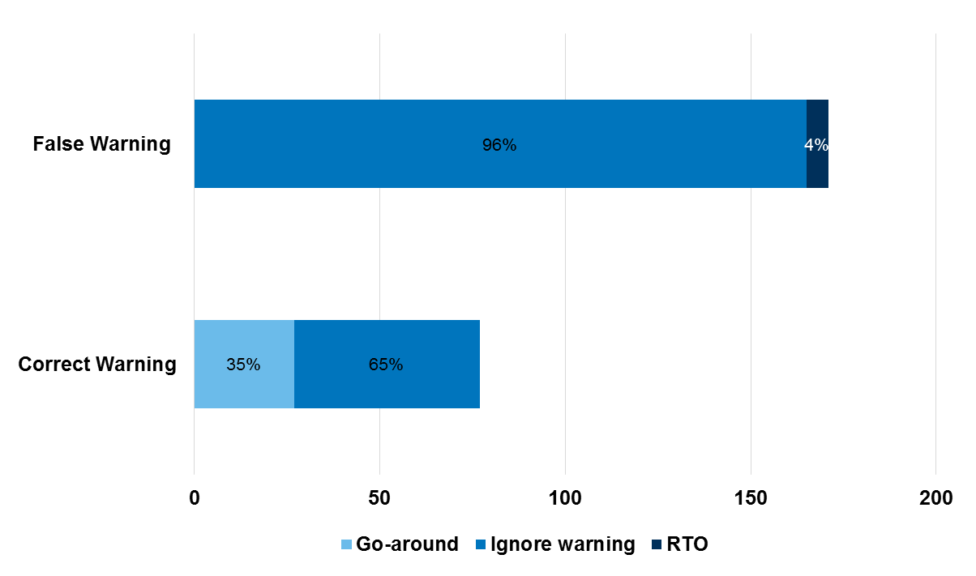
Runway Safety Nets – Countermeasure
72% (248) of report’s summary had information regarding the countermeasure.
31% (77) of reports had perceived correct warning
  A Go-around was performed in 35% (27) of correct warning reports. 19 of them due to unstable approach.
Copyright ©2016 International Air Transport Association. All rights reserved.
Subject to restrictions and disclaimer on page 2.

Slide 13
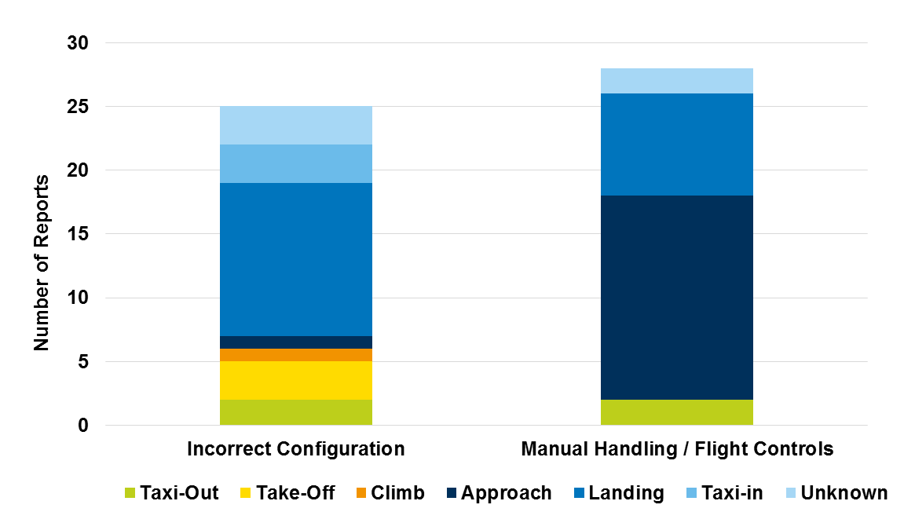
Runway Safety Nets – Issues Leading to the Warning
15% (53) of report’s summary had information regarding the errors that led up to the warning.
Copyright ©2016 International Air Transport Association. All rights reserved.
Subject to restrictions and disclaimer on page 2.

Slide 14
Quick ASR report review
What ASR reports tell us about ?
  Alerts and pilot response “as expected”
  Data base anomalies, lack of training, (perceived) wrong alerts,
  Few non compliances
What ASR reports do not tell us about ?
  Actual number of Safety Net events
  Errors scenarios leading to Safety Net alerts
  “Quality” of crew responses to Safety Net alert
What should be done further ?
  Assess the actual number of Safety Net event and average pilot exposure
  Rate of standard response
  ATC perspective of event involving both pilots and ATC
Copyright ©2016 International Air Transport Association. All rights reserved.
Subject to restrictions and disclaimer on page 2.

Slide 15
Runway Safety Nets – Examples (ROPS)
Example Report Narrative – “A go-around was performed during an approach to runway *** when the runway overrun protection system gave ROW of runway too short. The second approach to runway *** was uneventful.
Flight Safety update from FDM. (…) At 12 feet RA when the tailwind had increased to 13 knots a runway too short warning activated and a go-around was initiated. The main wheels touched down for 2 seconds at 749 meters from the runway threshold. The data will be shared with the manufacturer for feedback.”
Copyright ©2016 International Air Transport Association. All rights reserved.
Subject to restrictions and disclaimer on page 2.

Slide 16
Runway Safety Nets – Examples (ROPS)
Example Report Narrative – “The BTV set up for exiting runway *** at the runway end. Approaching the runway end with a speed of less than 10 knots and BTV disconnected a ROP audible warning "MAX BRAKING" activated. After vacating the runway and while taxiing on the parallel taxiway the same audible ROP warning activated numerous times.
Flight Safety update: Fleet Tech Pilots have previously replied that this is a known problem with RWY (***) where approximately the last 90m is used as a RESA. Data base provider is aware of the problem and is trying to develop a solution for this.
Copyright ©2016 International Air Transport Association. All rights reserved.
Subject to restrictions and disclaimer on page 2.

Slide 17
Runway Safety Nets – Examples (ROPS)
“The aircraft continued to float down the runway (…) and just before touchdown, ROPS announced “Runway Too Short!” This startled me because this was my first time hearing the ROPS system operate. At no time in my initial training nor in other SIM Sessions was this system demonstrated to me in the simulator”.
“(…) we did not touch down until at least midway down the field, maybe more, and heard the "Runway too short" callout in the airplane twice. CA landed (…), we should have gone around”.
“Captain landed long. ROPS warning sounded. (…) We did not realize procedure was to go around when warning sounded.”
Copyright ©2016 International Air Transport Association. All rights reserved.
Subject to restrictions and disclaimer on page 2.

Slide 18
Runway Safety Nets – Examples (RAAS)
Example Report Narrative
“- Radar vectored for final ILS runway 36. Ended up high on profile after series of track shortening. ROD increased (+/-2000fpm).
- Glide slope captured at 1300ft RA with landing gears down & flaps 15deg.
- Flaps 40deg landing was planned initially however due to approach speed still high, flaps 30deg was selected for landing (VREF 30: 147kts).
- RAAS triggered for "flaps", speed and "too fast" below 1000ft RA.
- A/c fully configured above 500ft RA in VMC however approach speed still high at +-165kts.
- Approach speed bleeds down to VREF 30 + 5 by minima.
- A/c landed uneventfully.”
Copyright ©2016 International Air Transport Association. All rights reserved.
Subject to restrictions and disclaimer on page 2.

Slide 19
Runway Safety Nets – Examples (RAAS)
Example Report Narratives
“During takeoff roll (…) we got twice the RAAS callout “On Taxiway". As it was clearly a wrong callout we continued the takeoff roll”
“Wrong RAAS callout of "On Taxiway on Taxiway" came on (…) just before touchdown. Alert was unexpected but landing was carried out uneventfully. Operating crew confirms that the RAAS callout was wrongly issued and can be hazardous when unexpected”.
“During a full length departure (…) an incorrect 'Caution on Taxiway' occurred. As the runway was positively identified the take-off was continued. Full runway length S10 is an addition to the old runway was therefore not yet be in the RAAS database”.
Copyright ©2016 International Air Transport Association. All rights reserved.
Subject to restrictions and disclaimer on page 2.

Slide 20
Runway Safety Nets – Examples (RWSL)
Example Report Narrative: “(…) The tower controller then cleared us to cross, but the runway entrance lights remained illuminated. We told the controller we were going to hold short because the lights were still on. He acknowledged and then told us that those lights are just for use with aircraft departing the runway, not arrivals. (…) We told him we were going to hold short because the RWSL lights remained illuminated. (…)
  Later as we departed ***, the ATIS stated: "RWSL in operation. Do not cross or depart against red lights." Additionally, upon inspection of company provided charts for ***, no mention is made of this RWSL system.”
Copyright ©2016 International Air Transport Association. All rights reserved.
Subject to restrictions and disclaimer on page 2.

Slide 21
Conclusion
As ultimate protections from catastrophic accident, Safety Nets should be specifically and explicitly addressed through SMS
Because they are rarely triggered, a dedicated effort to identify, monitor, assess and improve the most critical of them should be performed. Safety assumption should be systematically challenged.
Data collection regarding Safety Nets should be systematic. FDM data should be used as a primary source whenever possible. Data recorders & FDM tools should be designed in accordance. Data mining should be made more relevant by referring to potential accidents + related Safety Nets.
Safety Nets must be reliable, have not false warning and the system needs to trust them!

Slide 22
Questions ?

